Slide 1

INFRASTRUCTURE
as CODE
Running Microservices on AWS with Docker, Terraform, and ECS

Slide 2
Why infrastructure-as-code matters: a short story.

Slide 3
You are starting a
new project

Slide 4

I know, I’ll use Ruby on Rails!

Slide 5
> gem install rails

Slide 6
> gem install rails
Fetching: i18n-0.7.0.gem (100%)
Fetching: json-1.8.3.gem (100%)
Building native extensions. This could take a while...
ERROR: Error installing rails:
ERROR: Failed to build gem native extension.
/usr/bin/ruby1.9.1 extconf.rb
creating Makefile
make
sh: 1: make: not found

Slide 7
Ah, I just need to install make

Slide 8
> sudo apt-get install make
...
Success!

Slide 9
> gem install rails

Slide 10
> gem install rails
Fetching: nokogiri-1.6.7.2.gem (100%)
Building native extensions. This could take a while...
ERROR: Error installing rails:
ERROR: Failed to build gem native extension.
/usr/bin/ruby1.9.1 extconf.rb
checking if the C compiler accepts ... yes
Building nokogiri using packaged libraries.
Using mini_portile version 2.0.0.rc2
checking for gzdopen() in -lz... no
zlib is missing; necessary for building libxml2
*** extconf.rb failed ***

Slide 11

Hmm. Time to visit StackOverflow.

Slide 12
> sudo apt-get install zlib1g-dev
...
Success!

Slide 13
> gem install rails

Slide 14
> gem install rails
Building native extensions. This could take a while...
ERROR: Error installing rails:
ERROR: Failed to build gem native extension.
/usr/bin/ruby1.9.1 extconf.rb
checking if the C compiler accepts ... yes
Building nokogiri using packaged libraries.
Using mini_portile version 2.0.0.rc2
checking for gzdopen() in -lz... yes
checking for iconv... yes
Extracting libxml2-2.9.2.tar.gz into tmp/x86_64-pc-linux-gnu/ports/libxml2/2.9.2... OK
*** extconf.rb failed ***

Slide 15

nokogiri y u never install correctly?

Slide 16
(Spend 2 hours trying random StackOverflow suggestions)

Slide 17
> gem install rails

Slide 18
> gem install rails
...
Success!

Slide 19
Finally!

Slide 20
> rails new my-project
> cd my-project
> rails start

Slide 21
> rails new my-project
> cd my-project
> rails start
/source/my-project/bin/spring:11:in `<top (required)>': undefined method `path_separator' for Gem:Module (NoMethodError)
from bin/rails:3:in `load'
from bin/rails:3:in `<main>'

Slide 22


Slide 23
Eventually, you get it working

Slide 24
Now you have to deploy your
Rails app in production

Slide 25
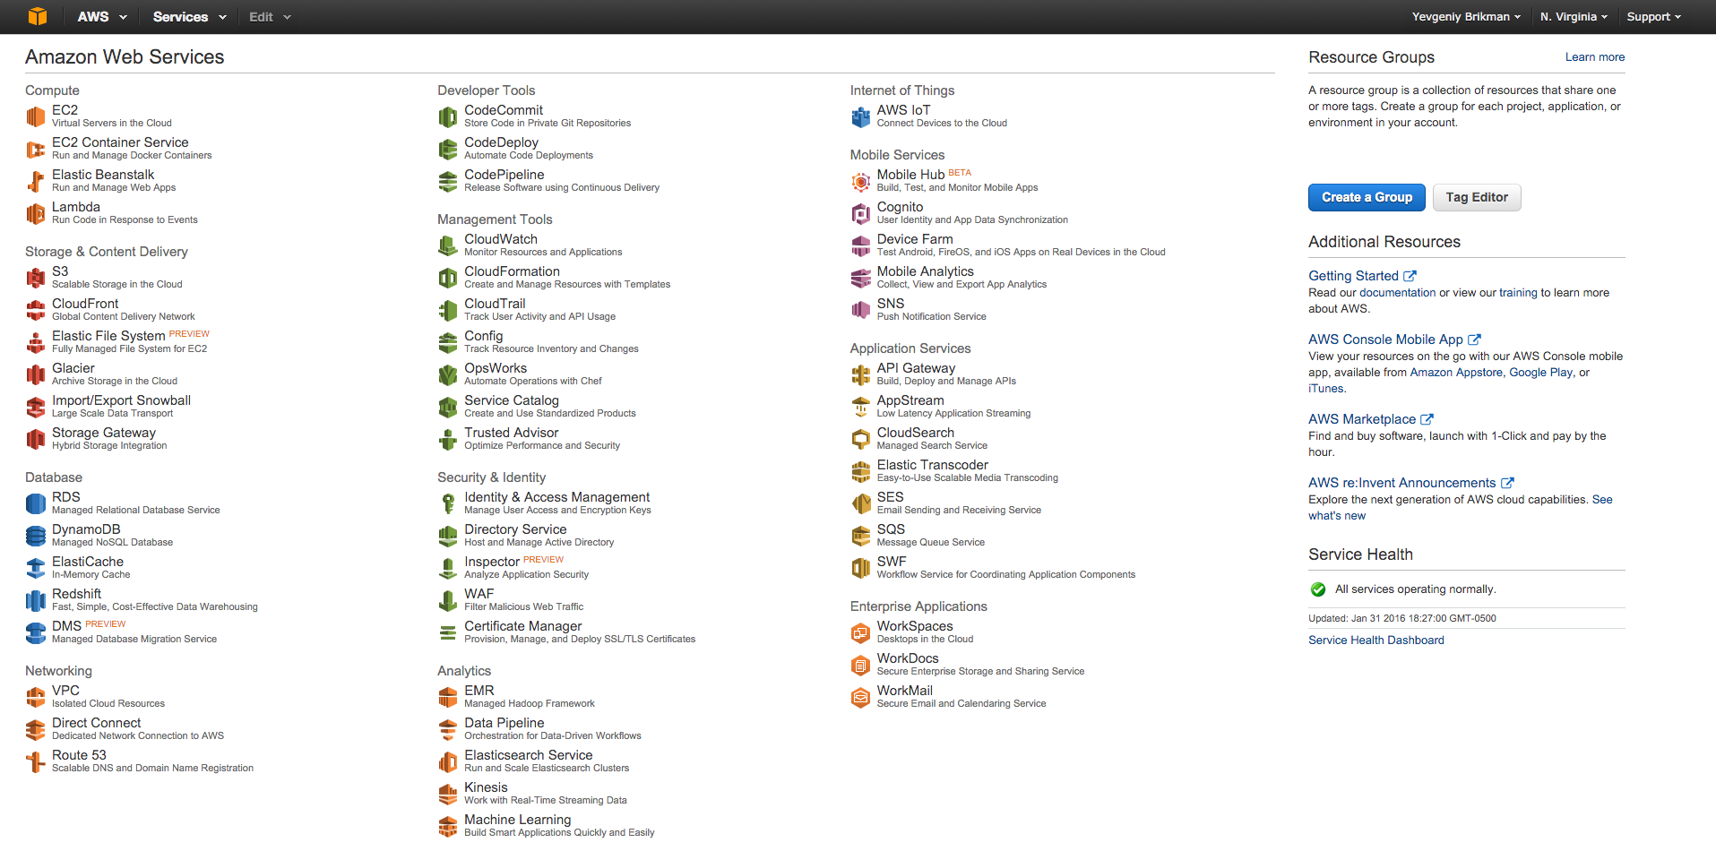
You use the AWS Console to deploy an EC2 instance

Slide 26
> ssh ec2-user@ec2-12-34-56-78.compute-1.amazonaws.com
__| __|_ )
_| ( / Amazon Linux AMI
___|\___|___|
[ec2-user@ip-172-31-61-204 ~]$ gem install rails

Slide 27
> ssh ec2-user@ec2-12-34-56-78.compute-1.amazonaws.com
__| __|_ )
_| ( / Amazon Linux AMI
___|\___|___|
[ec2-user@ip-172-31-61-204 ~]$ gem install rails
ERROR: Error installing rails:
ERROR: Failed to build gem native extension.
/usr/bin/ruby1.9.1 extconf.rb

Slide 29
Eventually you get it working

Slide 30
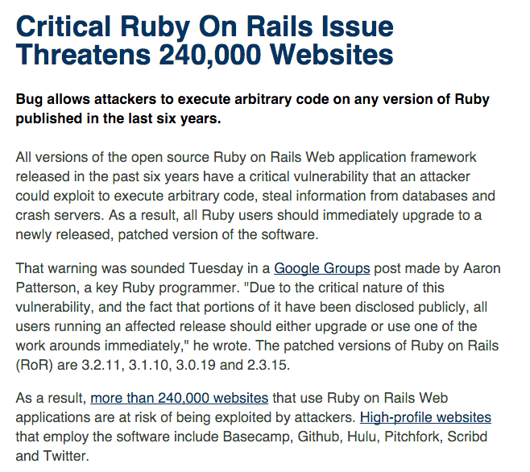

Slide 31
Now you urgently have to update all your Rails installs

Slide 32
> bundle update rails

Slide 33
> bundle update rails
Building native extensions. This could take a while...
ERROR: Error installing rails:
ERROR: Failed to build gem native extension.
/usr/bin/ruby1.9.1 extconf.rb
checking if the C compiler accepts ... yes
Building nokogiri using packaged libraries.
Using mini_portile version 2.0.0.rc2
checking for gzdopen() in -lz... yes
checking for iconv... yes
Extracting libxml2-2.9.2.tar.gz into tmp/x86_64-pc-linux-gnu/ports/libxml2/2.9.2... OK
*** extconf.rb failed ***

Slide 34


Slide 35
The problem isn’t Rails

Slide 36
> ssh ec2-user@ec2-12-34-56-78.compute-1.amazonaws.com
__| __|_ )
_| ( / Amazon Linux AMI
___|\___|___|
[ec2-user@ip-172-31-61-204 ~]$ gem install rails
The problem is that you’re configuring servers manually

Slide 37
And that you’re deploying infrastructure manually

Slide 38
A better alternative: infrastructure-as-code

Slide 39
In this talk, we’ll go through a real-world example:

Slide 40
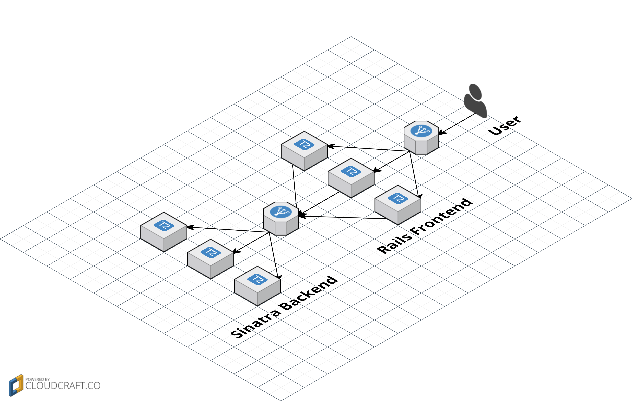
We’ll configure & deploy two microservices on AWS

Slide 41

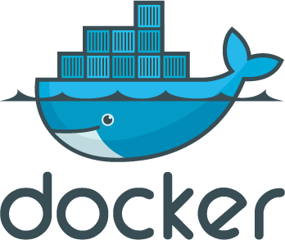
TERRAFORM
With two infrastructure-as-code tools: Docker and Terraform

Slide 42

I’m
Yevgeniy
Brikman
ybrikman.com

Slide 43

Founder
of
Atomic
Squirrel
atomic-squirrel.net

Slide 44





PAST LIVES

Slide 45
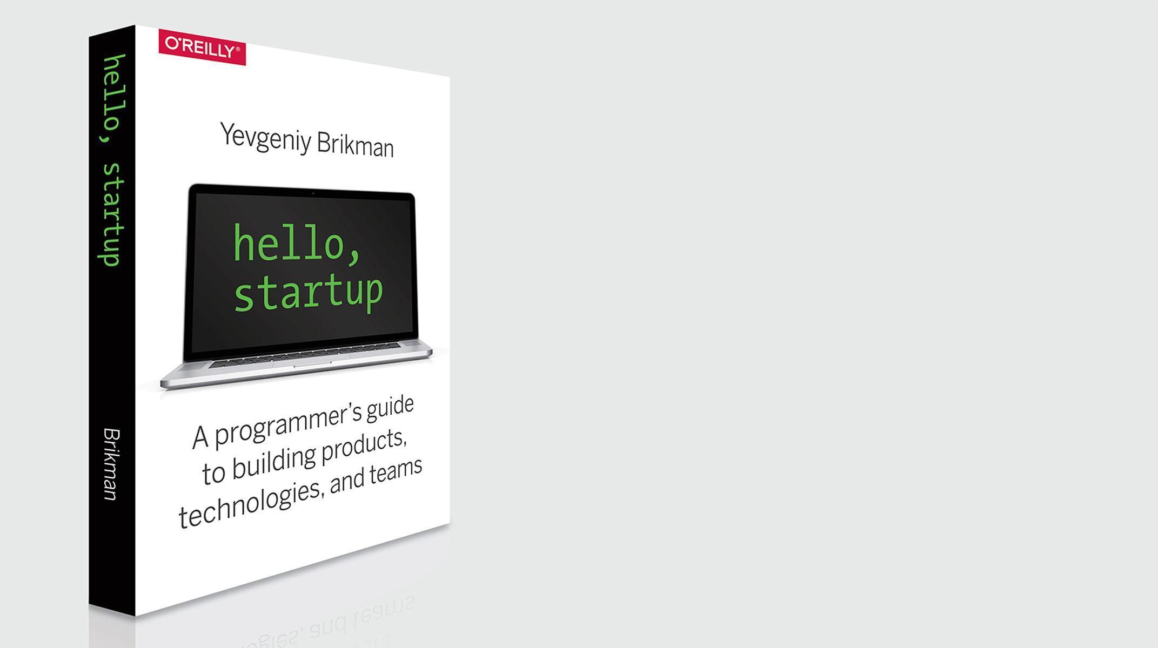
Author of
Hello, Startup
hello-startup.net

Slide 46
Slides and code from this talk:
ybrikman.com/speaking

Slide 47

Outline
Microservices
Docker
Terraform
ECS
Recap

Slide 48
Outline
Microservices
Docker
Terraform
ECS
Recap

Slide 49
Code is the enemy: the more you have, the slower you go

Slide 50
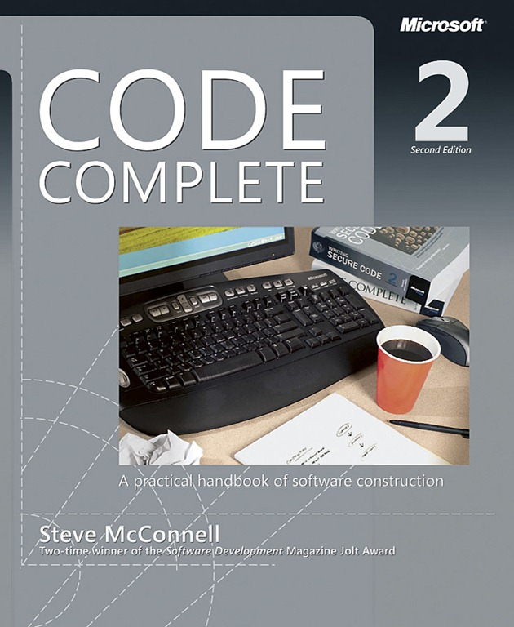
Project Size Lines of code | Bug Density Bugs per thousand lines of code
< 2K | 0 – 25
2K – 6K | 0 – 40
16K – 64K | 0.5 – 50
64K – 512K | 2 – 70
> 512K | 4 – 100

Slide 51
As the code grows, the number of bugs grows even faster

Slide 52
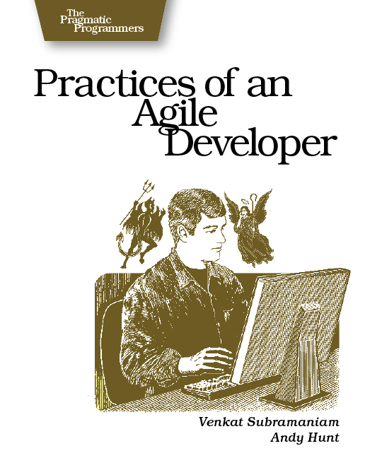
“Software development doesn't happen in a chart, an IDE, or a design tool; it happens in your head.”

Slide 53
The mind can only handle so much complexity at once

Slide 54
One solution is to break the code into microservices

Slide 55
moduleA.func()
moduleB.func()
moduleC.func()
moduleD.func()
moduleE.func()
In a monolith, you use function calls within one process

Slide 56
http://service.a
http://service.b
http://service.c
http://service.d
http://service.e
With services, you pass messages between processes

Slide 57
Advantages of services:
Isolation
Technology agnostic
Scalability

Slide 58
Disadvantages of services:
Operational overhead
Performance overhead
I/O, error handling
Backwards compatibility
Global changes, transactions, referential integrity all very hard

Slide 59
For more info, see: Splitting Up a Codebase into Microservices and Artifacts

Slide 60
For this talk, we’ll use two example microservices

Slide 61
require 'sinatra'
get "/" do
"Hello, World!"
end
A sinatra backend that returns “Hello, World”

Slide 62
class ApplicationController < ActionController::Base
def index
url = URI.parse(backend_addr)
req = Net::HTTP::Get.new(url.to_s)
res = Net::HTTP.start(url.host, url.port) {|http|
http.request(req)
}
@text = res.body
end
end
A rails frontend that calls the sinatra backend

Slide 63
<h1>Rails Frontend</h1>
<p>
Response from the backend: <strong><%= @text %></strong>
</p>
And renders the response as HTML

Slide 64
Outline
Microservices
Docker
Terraform
ECS
Recap

Slide 65
Docker allows you to build and run code in containers

Slide 66
Containers are like lightweight Virtual Machines (VMs)

Slide 67
App
App
App
Guest User Space
Guest User Space
Guest User Space
Guest OS
Guest OS
Guest OS
Virtualized hardware
Virtualized hardware
Virtualized hardware
Virtual Machine
Host User Space
Host OS
Hardware
VMs virtualize the hardware and run an entire guest OS on top of the host OS

Slide 68
App
App
App
Guest User Space
Guest User Space
Guest User Space
Guest OS
Guest OS
Guest OS
Virtualized hardware
Virtualized hardware
Virtualized hardware
Virtual Machine
Host User Space
Host OS
Hardware
This provides good isolation, but lots of CPU, memory, disk, & startup overhead

Slide 69
App
App
App
Guest User Space
Guest User Space
Guest User Space
Guest OS
Guest OS
Guest OS
App
App
App
Virtualized hardware
Virtualized hardware
Virtualized hardware
Virtualized
User Space
Virtualized
User Space
Virtualized
User Space
Virtual Machine
Container Engine
Host User Space
Host User Space
Host OS
Host OS
Hardware
Hardware
Containers virtualize User Space (shared memory, processes, mount, network)

Slide 70
App
App
App
Guest User Space
Guest User Space
Guest User Space
Guest OS
Guest OS
Guest OS
App
App
App
Virtualized hardware
Virtualized hardware
Virtualized hardware
Virtualized
User Space
Virtualized
User Space
Virtualized
User Space
Virtual Machine
Container Engine
Host User Space
Host User Space
Host OS
Host OS
Hardware
Hardware
Isolation isn’t as good, but much less CPU, memory, disk, & startup overhead

Slide 71
> docker run –it ubuntu bash
root@12345:/# echo "I'm in $(cat /etc/issue)”
I'm in Ubuntu 14.04.4 LTS
Running Ubuntu in a Docker container

Slide 72
> time docker run ubuntu echo "Hello, World"
Hello, World
real 0m0.183s
user 0m0.009s
sys 0m0.014s
Containers boot very quickly. Easily run a dozen at once.

Slide 73
You can define a Docker image as code in a Dockerfile

Slide 74
FROM gliderlabs/alpine:3.3
RUN apk --no-cache add ruby ruby-dev
RUN gem install sinatra --no-ri --no-rdoc
RUN mkdir -p /usr/src/app
COPY . /usr/src/app
WORKDIR /usr/src/app
EXPOSE 4567
CMD ["ruby", "app.rb"]
Here is the Dockerfile for the Sinatra backend

Slide 75
FROM gliderlabs/alpine:3.3
RUN apk --no-cache add ruby ruby-dev
RUN gem install sinatra --no-ri --no-rdoc
RUN mkdir -p /usr/src/app
COPY . /usr/src/app
WORKDIR /usr/src/app
EXPOSE 4567
CMD ["ruby", "app.rb"]
It specifies dependencies, code, config, and how to run the app

Slide 76
> docker build -t brikis98/sinatra-backend .
Step 0 : FROM gliderlabs/alpine:3.3
---> 0a7e169bce21
(...)
Step 8 : CMD ruby app.rb
---> 2e243eba30ed
Successfully built 2e243eba30ed
Building a Docker image

Slide 77
> docker run -it -p 4567:4567 brikis98/sinatra-backend
INFO WEBrick 1.3.1
INFO ruby 2.2.4 (2015-12-16) [x86_64-linux-musl]
== Sinatra (v1.4.7) has taken the stage on 4567 for development with backup from WEBrick
INFO WEBrick::HTTPServer#start: pid=1 port=4567
Running a Docker image

Slide 78
> docker push brikis98/sinatra-backend
The push refers to a repository [docker.io/brikis98/sinatra-backend] (len: 1)
2e243eba30ed: Image successfully pushed
7e2e0c53e246: Image successfully pushed
919d9a73b500: Image successfully pushed
(...)
v1: digest: sha256:09f48ed773966ec7fe4558 size: 14319
You can share your images by pushing them to Docker Hub

Slide 79
Now you can reuse the same image in dev, stg, prod, etc

Slide 80
> docker pull rails:4.2.6
And you can reuse images created by others.

Slide 81
FROM rails:4.2.6
RUN mkdir -p /usr/src/app
COPY . /usr/src/app
WORKDIR /usr/src/app
RUN bundle install
EXPOSE 3000
CMD ["rails", "start"]
The rails-frontend is built on top of the official rails Docker image

Slide 82

No more insane install procedures!

Slide 83
rails_frontend:
image: brikis98/rails-frontend
ports:
- "3000:3000"
links:
- sinatra_backend:sinatra_backend
sinatra_backend:
image: brikis98/sinatra-backend
ports:
- "4567:4567"
Define your entire dev stack as code with docker-compose

Slide 84
rails_frontend:
image: brikis98/rails-frontend
ports:
- "3000:3000"
links:
- sinatra_backend:sinatra_backend
sinatra_backend:
image: brikis98/sinatra-backend
ports:
- "4567:4567"
Docker links provide a simple service discovery mechanism

Slide 85
> docker-compose up
Starting infrastructureascodetalk_sinatra_backend_1
Recreating infrastructureascodetalk_rails_frontend_1
sinatra_backend_1 | INFO WEBrick 1.3.1
sinatra_backend_1 | INFO ruby 2.2.4 (2015-12-16)
sinatra_backend_1 | Sinatra has taken the stage on 4567
rails_frontend_1 | INFO WEBrick 1.3.1
rails_frontend_1 | INFO ruby 2.3.0 (2015-12-25)
rails_frontend_1 | INFO WEBrick::HTTPServer#start: port=3000
Run your entire dev stack with one command

Slide 86
Advantages of Docker:
Easy to create & share images
Images run the same way in all environments (dev, test, prod)
Easily run the entire stack in dev
Minimal overhead
Better resource utilization

Slide 87
Disadvantages of Docker:
Maturity. Ecosystem developing very fast, but still a ways to go
Tricky to manage persistent data in a container

Slide 88
Outline
Microservices
Docker
Terraform
ECS
Recap

Slide 89
Terraform is a tool for provisioning infrastructure

Slide 90
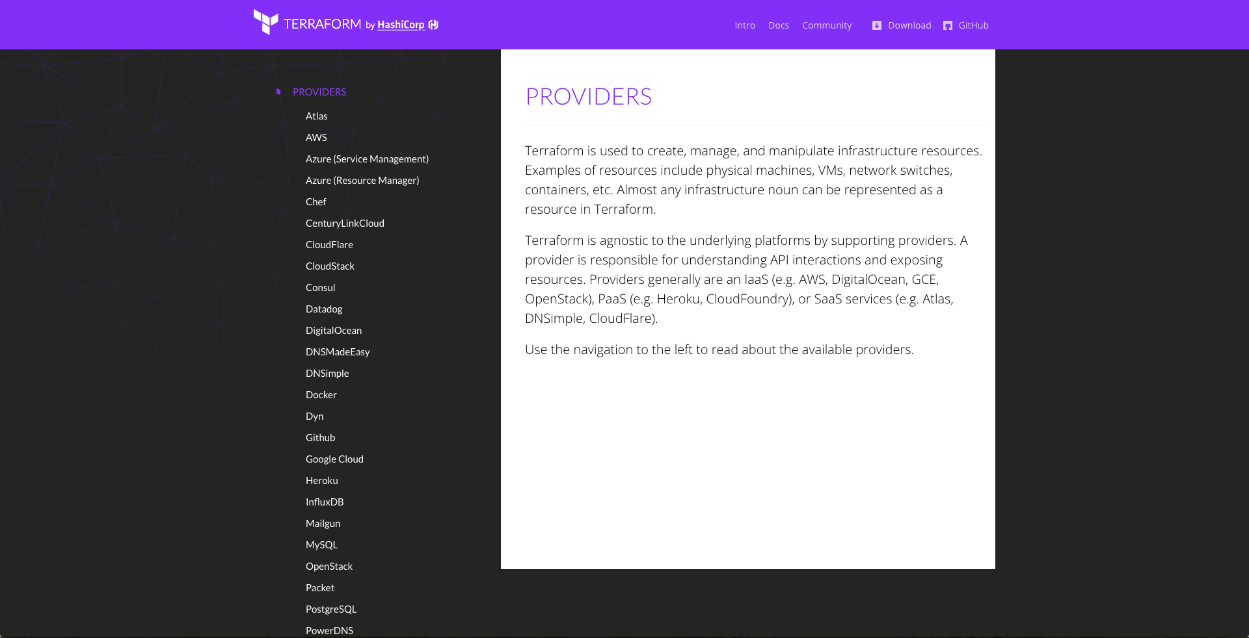
Terraform supports many providers (cloud agnostic)

Slide 91
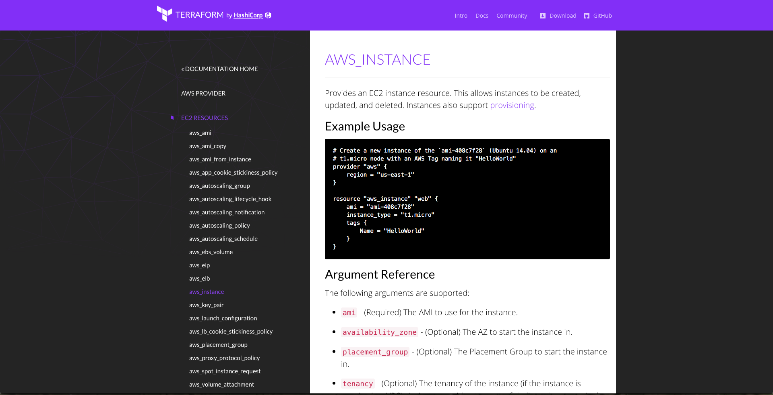
And many resources for each provider

Slide 92
You define resources as code in Terraform templates

Slide 93
provider "aws" {
access_key = "ACCESS_KEY_HERE"
secret_key = "SECRET_KEY_HERE"
region = "us-east-1"
}
resource "aws_instance" "example" {
ami = "ami-408c7f28"
instance_type = "t2.micro"
}
This template creates a single EC2 instance in AWS

Slide 94
> terraform plan
+ aws_instance.example
ami: "" => "ami-408c7f28"
instance_type: "" => "t2.micro"
key_name: "" => "<computed>"
private_ip: "" => "<computed>"
public_ip: "" => "<computed>"
Plan: 1 to add, 0 to change, 0 to destroy.
Use the plan command to see what you’re about to deploy

Slide 95
> terraform apply
aws_instance.example: Creating...
ami: "" => "ami-408c7f28"
instance_type: "" => "t2.micro"
key_name: "" => "<computed>"
private_ip: "" => "<computed>"
public_ip: "" => "<computed>”
aws_instance.example: Creation complete
Apply complete! Resources: 1 added, 0 changed, 0 destroyed.
Use the apply command to apply the changes

Slide 96
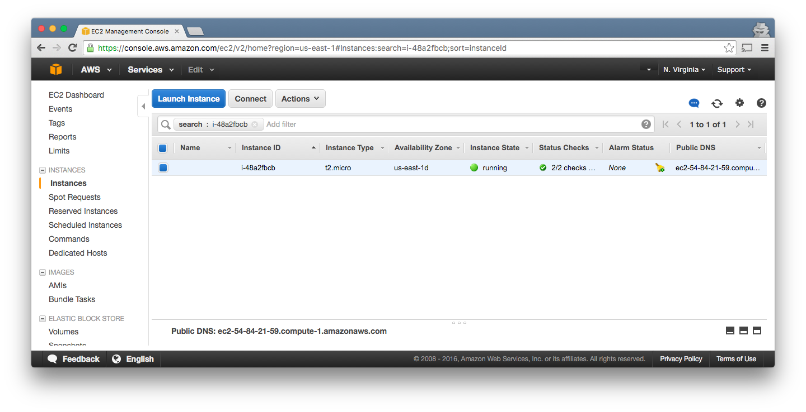
Now our EC2 instance is running!

Slide 97
resource "aws_instance" "example" {
ami = "ami-408c7f28"
instance_type = "t2.micro"
tags {
Name = "terraform-example"
}
}
Let’s give the EC2 instance a tag with a readable name

Slide 98
> terraform plan
~ aws_instance.example
tags.#: "0" => "1"
tags.Name: "" => "terraform-example"
Plan: 0 to add, 1 to change, 0 to destroy.
Use the plan command again to verify your changes

Slide 99
> terraform apply
aws_instance.example: Refreshing state...
aws_instance.example: Modifying...
tags.#: "0" => "1"
tags.Name: "" => "terraform-example"
aws_instance.example: Modifications complete
Apply complete! Resources: 0 added, 1 changed, 0 destroyed.
Use the apply command again to deploy those changes

Slide 100
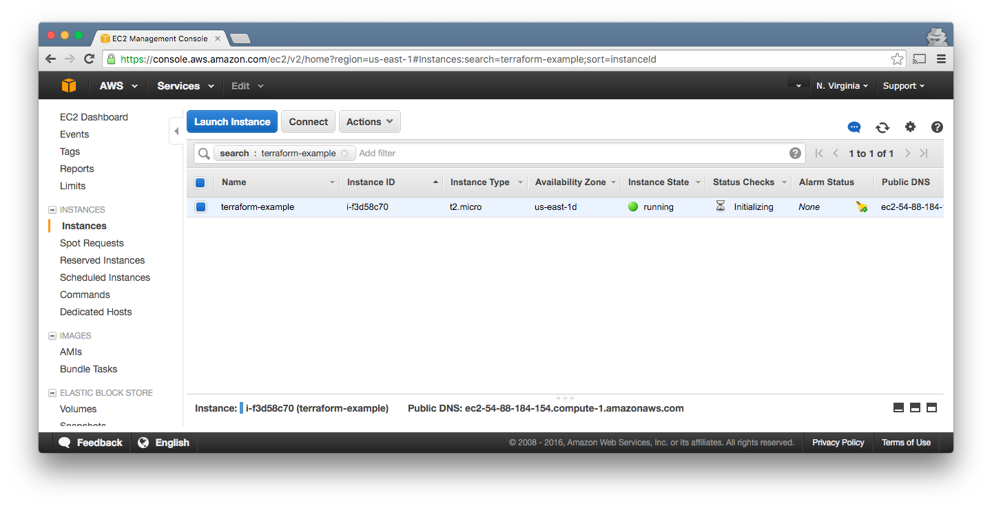
Now our EC2 instance has a tag!

Slide 101
resource "aws_elb" "example" {
name = "example"
availability_zones = ["us-east-1a", "us-east-1b"]
instances = ["${aws_instance.example.id}"]
listener {
lb_port = 80
lb_protocol = "http"
instance_port = "${var.instance_port}"
instance_protocol = "http”
}
}
Let’s add an Elastic Load Balancer (ELB).

Slide 102
resource "aws_elb" "example" {
name = "example"
availability_zones = ["us-east-1a", "us-east-1b"]
instances = ["${aws_instance.example.id}"]
listener {
lb_port = 80
lb_protocol = "http"
instance_port = "${var.instance_port}"
instance_protocol = "http”
}
}
Terraform supports variables, such as var.instance_port.

Slide 103
resource "aws_elb" "example" {
name = "example"
availability_zones = ["us-east-1a", "us-east-1b"]
instances = ["${aws_instance.example.id}"]
listener {
lb_port = 80
lb_protocol = "http"
instance_port = "${var.instance_port}"
instance_protocol = "http"
}
}
As well as dependencies like aws_instance.example.id

Slide 104
resource "aws_elb" "example" {
name = "example"
availability_zones = ["us-east-1a", "us-east-1b"]
instances = ["${aws_instance.example.id}"]
listener {
lb_port = 80
lb_protocol = "http"
instance_port = "${var.instance_port}"
instance_protocol = "http"
}
}
It builds a dependency graph and applies it in parallel.

Slide 105
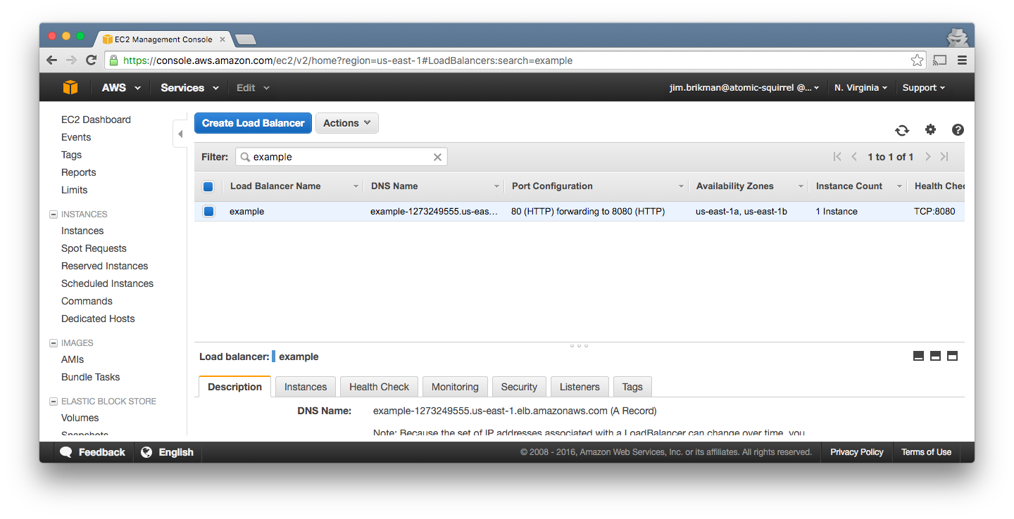
After running apply, we have an ELB!

Slide 106
> terraform destroy
aws_instance.example: Refreshing state... (ID: i-f3d58c70)
aws_elb.example: Refreshing state... (ID: example)
aws_elb.example: Destroying...
aws_elb.example: Destruction complete
aws_instance.example: Destroying...
aws_instance.example: Destruction complete
Apply complete! Resources: 0 added, 0 changed, 2 destroyed.
Use the destroy command to delete all your resources

Slide 107
Advantages of Terraform:
Concise, readable syntax
Reusable code: inputs, outputs, modules
Plan command!
Cloud agnostic
Very active development

Slide 108
Disadvantages of Terraform:
Maturity
Collaboration on Terraform state is hard (email me if you’re interested in an alternative!)
No rollback
Poor secrets management

Slide 109
Outline
Microservices
Docker
Terraform
ECS
Recap

Slide 110
EC2 Container Service (ECS) is a way to run Docker on AWS

Slide 111
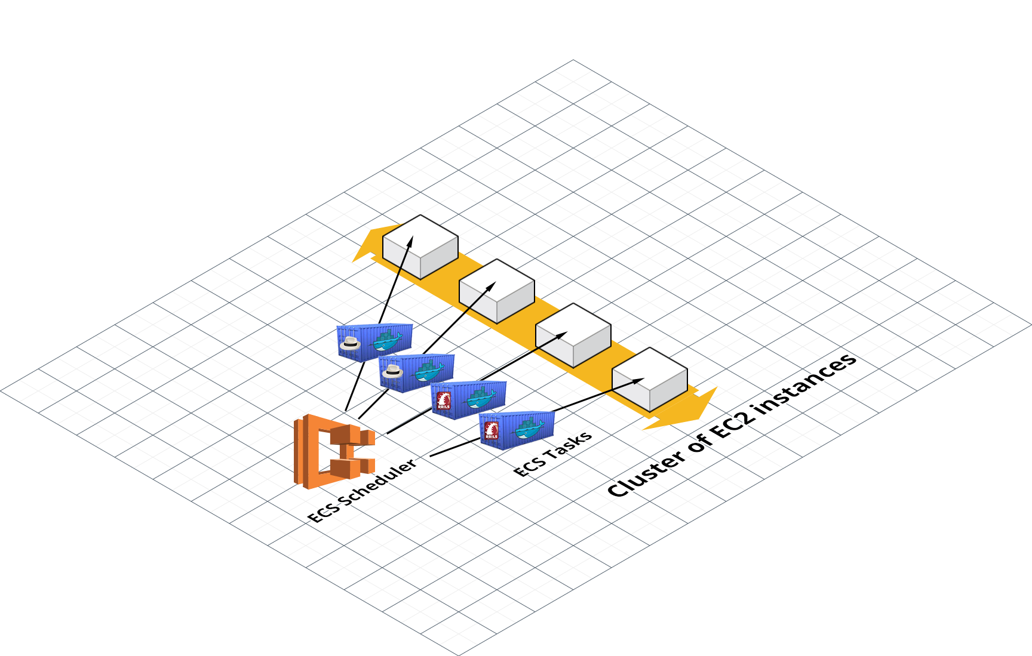
ECS Overview

Slide 112
Some ECS terminology:

Slide 113
ECS cluster: A bunch of EC2 instances managed by ECS

Slide 114
ECS Task: Docker container(s) to run + the resources they need

Slide 115
ECS Scheduler: Deploys ECS Tasks across an ECS Cluster

Slide 116
ECS Service: A way to manage long-running ECS Tasks

Slide 117
Let’s define these as code
using Terraform

Slide 118
resource "aws_ecs_cluster" "example_cluster" {
name = "example-cluster"
}
resource "aws_autoscaling_group" "ecs_cluster_instances" {
name = "ecs-cluster-instances"
min_size = 3
max_size = 3
launch_configuration =
"${aws_launch_configuration.ecs_instance.name}"
}
Define the ECS Cluster as an Auto Scaling Group (ASG)

Slide 119
# The launch config defines what runs on each EC2 instance
resource "aws_launch_configuration" "ecs_instance" {
name_prefix = "ecs-instance-"
instance_type = "t2.micro"
# This is an Amazon ECS AMI, which has an ECS Agent
# installed that lets it talk to the ECS cluster
image_id = "ami-a98cb2c3”
}
Each EC2 instance in the cluster needs to run the ECS Agent

Slide 120
resource "aws_ecs_task_definition" "rails_frontend" {
family = "rails-frontend"
container_definitions = <<EOF
[{
"name": "rails-frontend",
"image": "brikis98/rails-frontend:v1",
"cpu": 1024,
"memory": 768,
"essential": true,
"portMappings": [{"containerPort": 3000, "hostPort": 3000}]
}]
EOF
}
Define an ECS Task for the Rails Frontend microservice

Slide 121
resource "aws_ecs_task_definition" "sinatra_backend" {
family = "sinatra-backend"
container_definitions = <<EOF
[{
"name": "sinatra-backend",
"image": "brikis98/sinatra-backend:v1",
"cpu": 1024,
"memory": 768,
"essential": true,
"portMappings": [{"containerPort": 4567, "hostPort": 4567}]
}]
EOF
}
Define an ECS Task for the Sinatra Backend microservice

Slide 122
resource "aws_ecs_service" "rails_frontend" {
family = "rails-frontend"
cluster = "${aws_ecs_cluster.example_cluster.id}"
task_definition =
"${aws_ecs_task_definition.rails-fronted.arn}"
desired_count = 2
}
Define an ECS Service for the Rails Frontend ECS Task

Slide 123
resource "aws_ecs_service" "sinatra_backend" {
family = "sinatra-backend"
cluster = "${aws_ecs_cluster.example_cluster.id}"
task_definition =
"${aws_ecs_task_definition.sinatra_backend.arn}"
desired_count = 2
}
Define an ECS Service for the Sinatra Backend ECS Task

Slide 124
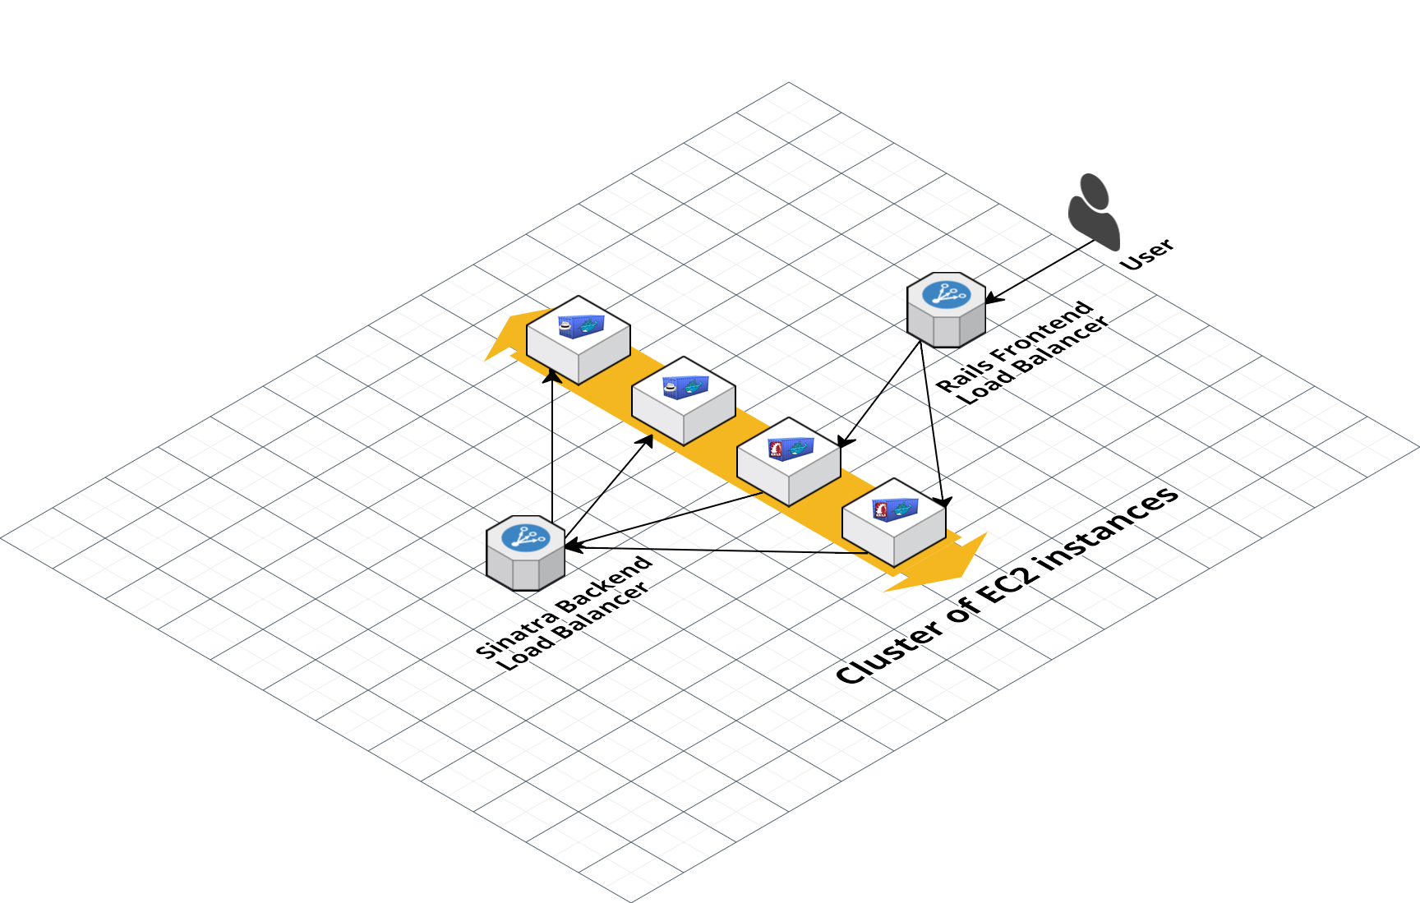
Each ECS Service can be associated with an Elastic Load Balancer (ELB)

Slide 125
resource "aws_elb" "rails_frontend" {
name = "rails-frontend"
listener {
lb_port = 80
lb_protocol = "http"
instance_port = 3000
instance_protocol = "http"
}
}
Define an ELB for the Rails Frontend ECS Service

Slide 126
resource "aws_ecs_service" "rails_frontend" {
(...)
load_balancer {
elb_name = "${aws_elb.rails_frontend.id}"
container_name = "rails-frontend"
container_port = 3000
}
}
Associate the ELB with the Rails Frontend ECS Service

Slide 127
resource "aws_elb" "sinatra_backend" {
name = "sinatra-backend"
listener {
lb_port = 4567
lb_protocol = "http"
instance_port = 4567
instance_protocol = "http"
}
}
Define an ELB for the Sinatra Backend ECS Service

Slide 128
resource "aws_ecs_service" "sinatra_backend" {
(...)
load_balancer {
elb_name = "${aws_elb.sinatra_backend.id}"
container_name = "sinatra-backend"
container_port = 4567
}
}
Associate the ELB with the Sinatra Backend ECS Service

Slide 129
resource "aws_ecs_task_definition" "rails_frontend" {
family = "rails-frontend"
container_definitions = <<EOF
[{
...
"environment": [{
"name": "SINATRA_BACKEND_PORT",
"value": "tcp://${aws_elb.sinatra_backend.dns_name}:4567"
}]
}]
EOF
}
Pass the Sinatra Bckend ELB URL as env var to Rails Frontend

Slide 130
resource "aws_ecs_task_definition" "rails_frontend" {
family = "rails-frontend"
container_definitions = <<EOF
[{
...
"environment": [{
"name": "SINATRA_BACKEND_PORT",
"value": "tcp://${aws_elb.sinatra_backend.dns_name}:4567"
}]
}]
EOF
}
This is a simple “service discovery” mechanism

Slide 131
> terraform apply
aws_ecs_cluster.example_cluster: Creating...
name: "" => "example-cluster"
aws_ecs_task_definition.sinatra_backend: Creating...
...
Apply complete! Resources: 17 added, 0 changed, 0 destroyed.
Use the apply command to deploy the ECS cluster

Slide 132
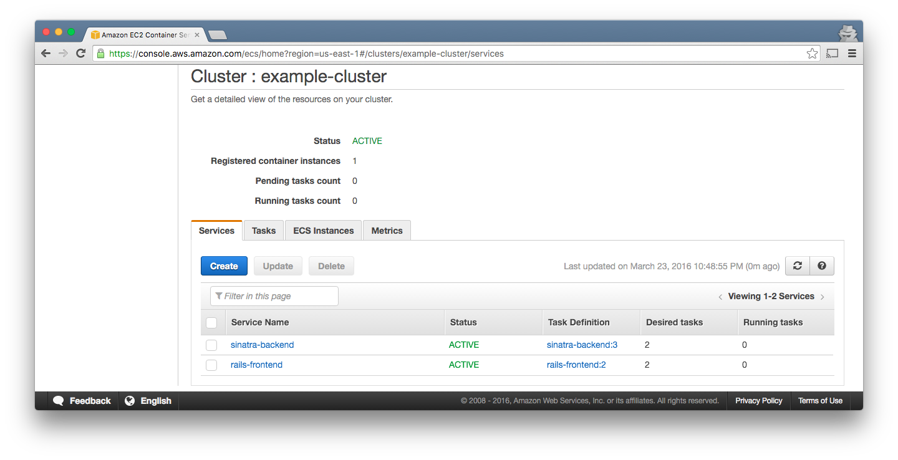
See the cluster in the ECS console

Slide 133
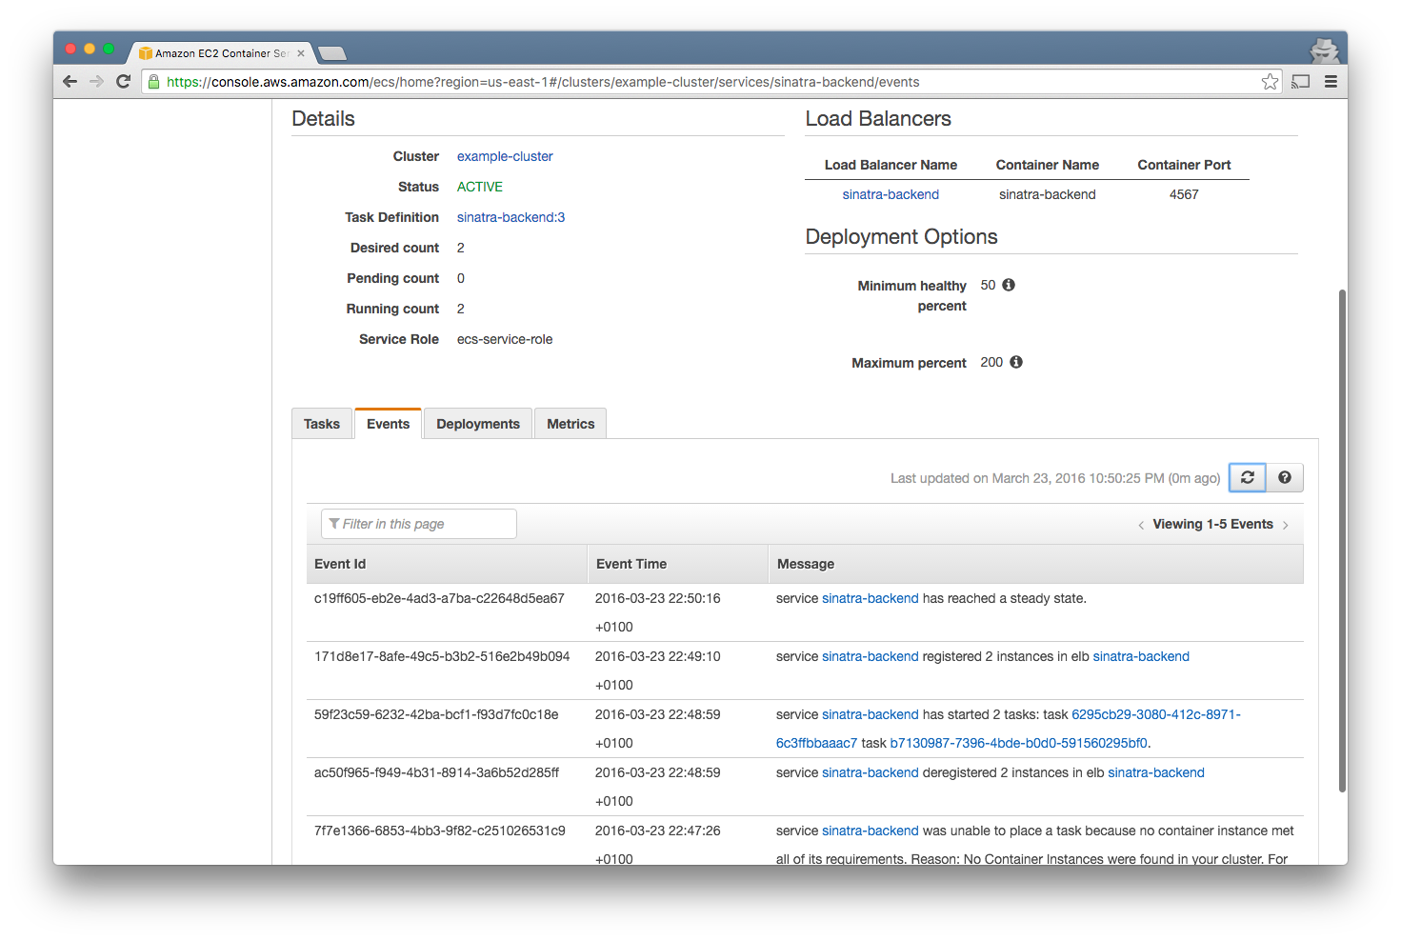
Track events for each Service

Slide 134
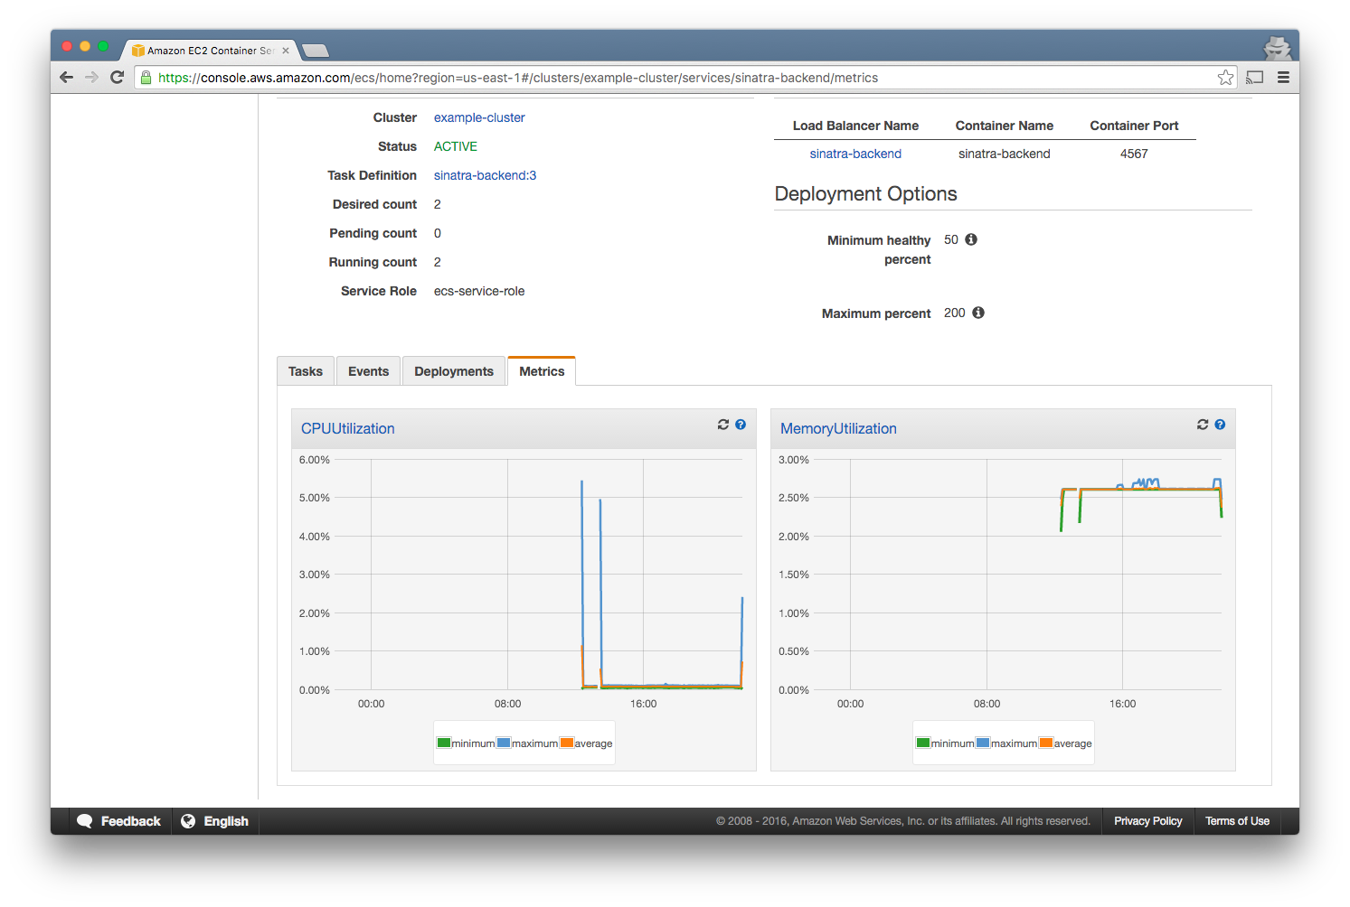
As well as very basic metrics

Slide 135
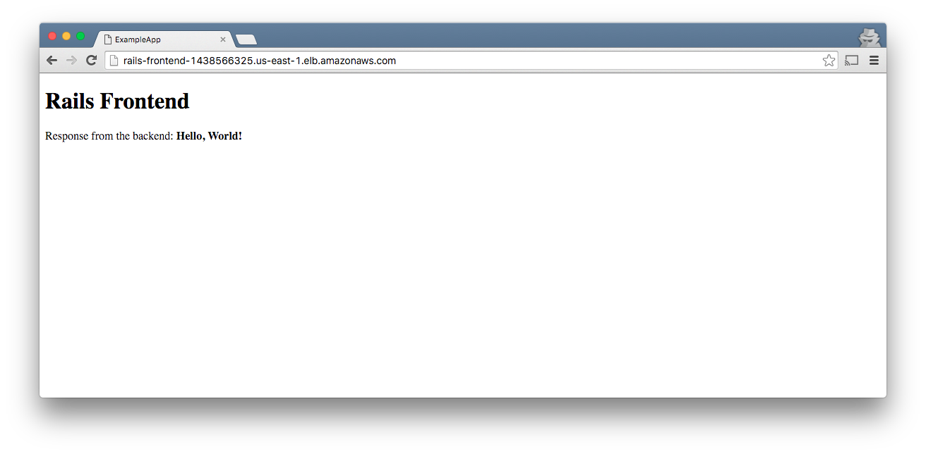
Test the rails-frontend

Slide 136
resource "aws_ecs_task_definition" "sinatra_backend" {
family = "sinatra-backend"
container_definitions = <<EOF
[{
"name": "sinatra-backend",
"image": "brikis98/sinatra-backend:v2",
...
}
To deploy a new image, just update the docker tag

Slide 137
> terraform plan
~ aws_ecs_service.sinatra_backend
task_definition: "arn...sinatra-backend:3" => "<computed>"
-/+ aws_ecs_task_definition.sinatra_backend
arn: "arn...sinatra-backend:3" => "<computed>"
container_definitions: "bb5352f" => "2ff6ae" (forces new resource)
revision: "3" => "<computed>”
Plan: 1 to add, 1 to change, 1 to destroy.
Use the plan command to verify the changes

Slide 138

Apply the changes and you’ll see v2.

Slide 139
Advantages of ECS:
One of the simplest Docker cluster management tools
Almost no extra cost if on AWS
Pluggable scheduler
Auto-restart of instances & Tasks
Automatic ELB integration

Slide 140
Disadvantages of ECS:
No auto scaling integration
Limited to one ELB per service
UI is so-so
Minimal monitoring built-in
No built-in service discovery
Entire cluster in one subnet

Slide 141
Outline
Microservices
Docker
Terraform
ECS
Recap

Slide 142
Benefits of infrastructure-as-code:
Reuse
Automation
Version control
Code review
Documentation
Testing

Slide 143
Slides and code from this talk:
ybrikman.com/speaking

Slide 144
For more info, see
Hello, Startup
hello-startup.net

Slide 145
For DevOps help, see
Atomic
Squirrel
atomic-squirrel.net

Slide 146

Questions?

